Slide 1
Introduction to SAP Functional ERP Modules

Slide 2
SAP PP (Production Planning)
Production Planning is the process of aligning demand with manufacturing capacity to create production and procurement schedules for finished products and component materials.
SAP PP is an important module of SAP. It tracks and makes a record of the manufacturing process flows, for example, the planned and actual costs. Also, goods movements from the conversion of raw material to semi-finished goods.
What is Production Planning?

Slide 3
Organization Structure in SAP PP
In any live Production Planning module, locations of manufacturing plants and storage within the plants, should be available in the system.
Importance of Plant and storage locations in Production Planning-
All Production master data is created at Plant level.
Planning activities are also performed at Plant level.
Production Confirmation process and related goods movement occur at plant and storage location level.

Slide 4
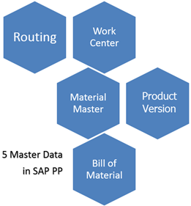
Master Data in SAP PP

Slide 5
Material Master
Work Centre
To purchase materials
For Goods Movement postings such as goods issue or receipt in inventory management and also for physical inventory postings
In invoice verification for posting invoices
In sales and distribution for sales order fulfillment process
Bill of Master (BOM)
A bill of material is a complete, formally structured list of the components together with the quantity required to produce the product or assembly.
For example, Product Cycle can contain all types of frames (with different colours and sizes) and desired frame is selected in production order based on colour and size chosen in the sales order.
A Work Centre is a machine or group of machines where production operations are performed. Work centres are used in task list operations (Routings).
It contains the data for
Scheduling
Capacity
Costing
Routing
The production version is a combination of BOM and Routing data for production. It is a linkage between BOM & Routing and determines the manufacturing process.
Routing is nothing but a sequence of operation performed at the Work Centre. It also specifies the machine time, labour time, etc. for the execution of operations.
Production version

Slide 6
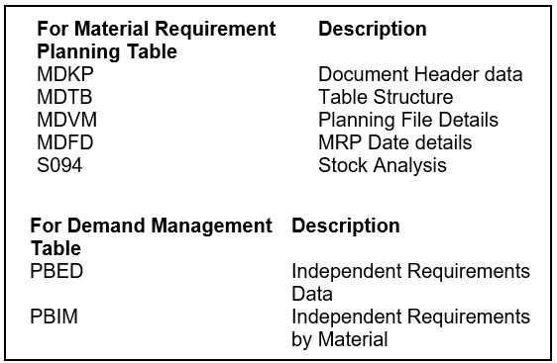
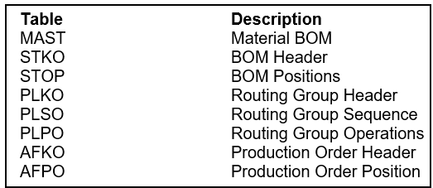
SAP PP – Common Tables
There are various tables in SAP PP system for BOM, routing, discrete production, material allocation, goods receipts, etc

Slide 7
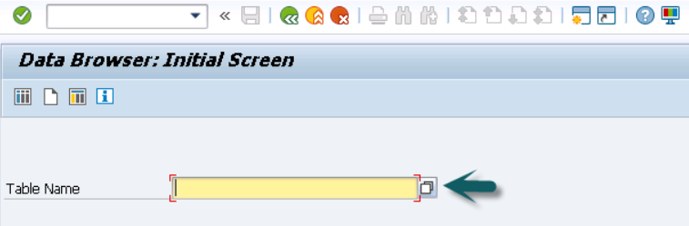
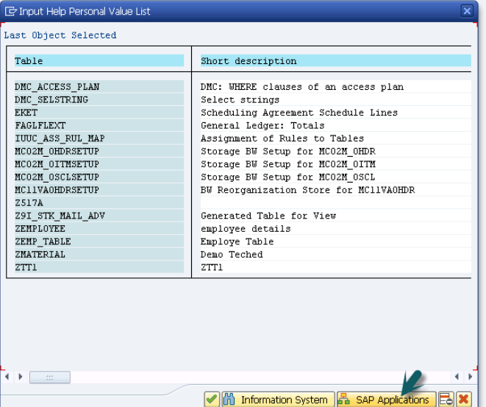
How to View SAP PP Tables in SAP ERP System?
Step 1: In ERP system, use T-Code: SE16.
Step 2: Go to SAP Applications.

Slide 8
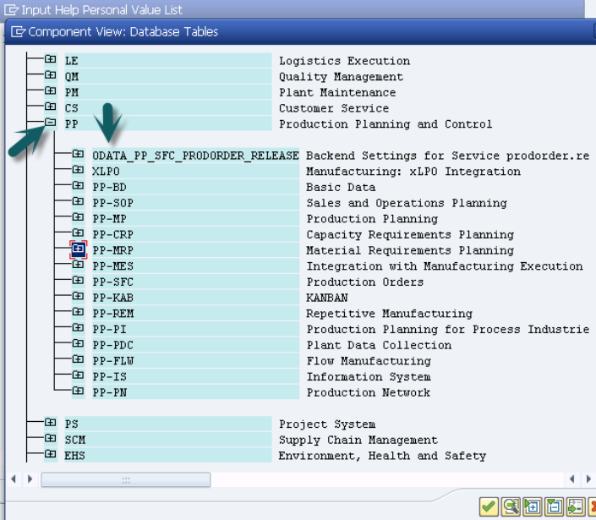
Step 3: Click the ‘+’ sign and you can see the list of all tables in ERP as shown in the following screenshot.

Slide 9
SAP MM (Material Management)
SAP MM is the short form for SAP Material Management system. The roles of SAP MM in a business process are as follows −
A business process in SAP is termed as a “module”.
SAP MM is a part of logistics functions and it helps in managing the procurement activities of an organization.
It supports all aspects of material management (planning, control, etc.).
It is the backbone of logistics that incorporates modules such as Sales and Distribution, Production Planning, Plant Maintenance, Project Systems, and Warehouse Management.

Slide 10
Features of SAP MM
Material Management as a process ensures no shortage of materials or any gaps in the supply chain process of the organization.
It deals with managing the materials (products and/or services) and resources of an organization with the aim of accelerating productivity and reducing costs.
SAP MM is one of the modules of SAP that deals with material management and inventory management.
It deals with the Procurement Process, Master Data (Material & Vendor Master), Account Determination & Valuation of Material, Inventory Management, Invoice Verification, Material Requirement Planning, etc.

Slide 11
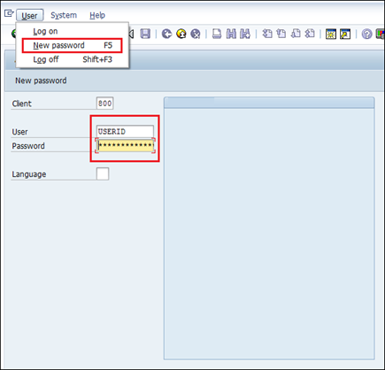
Screen Navigation
Login Screen
Log on to the SAP ERP server. The SAP login screen will prompt you for the User ID and the Password. Provide a valid user ID and password and press enter. The user id and password are provided by the system administrator.
Reference: https://www.tutorialspoint.com/sap_mm/sap_mm_screen_navigation.htm

Slide 12
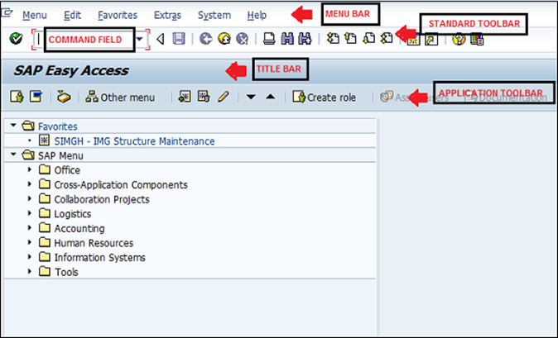
Menu Bar
Standard Toolbar
Title Bar
Application Toolbar
Command Field
Standard Toolbar Icon
Reference: https://www.tutorialspoint.com/sap_mm/sap_mm_screen_navigation.htm

Slide 13
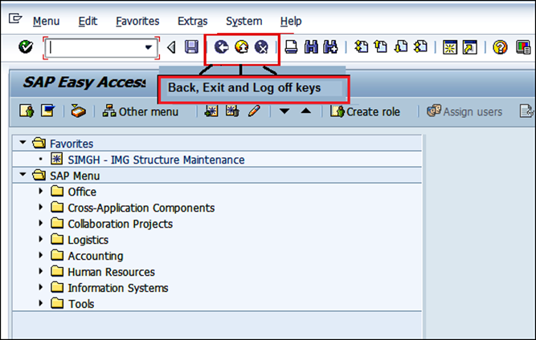
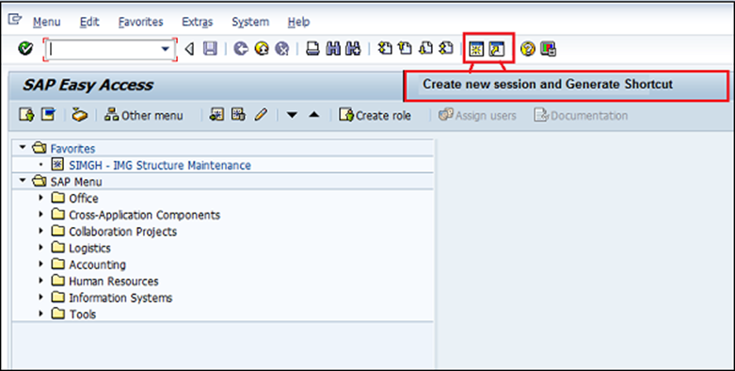
Standard Exit Keys
Exit keys are used to exit the module or to log off. They are used to go back to the last accessed screen.
New Session Icon
For creating a new session, we use the following key.
Reference: https://www.tutorialspoint.com/sap_mm/sap_mm_screen_navigation.htm

Slide 14
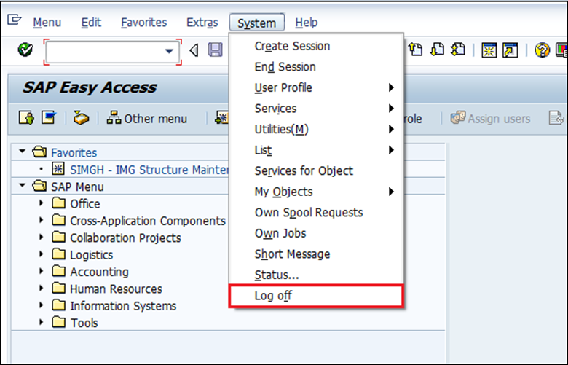
Log Off
It is a good practice to log off from the SAP system when you finish your work. There are several ways to log off from the system
Reference: https://www.tutorialspoint.com/sap_mm/sap_mm_screen_navigation.htm

Slide 15
SAP PS (Project System)
The Project System (PS) module of SAP is specifically designed to provide comprehensive and fully integrated project management functionality for SAP customers. A Project is a complex undertaking, bringing with it huge data of different type.

Slide 16
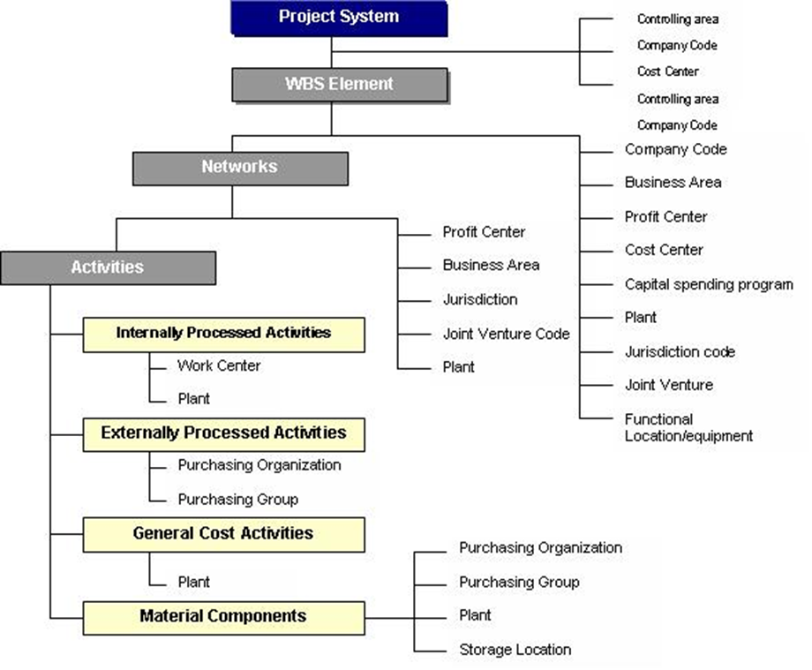
Organizational Structures in Project System

Slide 17
Project Definition
Project Definition is general description of the project that you want to manage. It is a framework laid down for all the objects created within a project.
Work Breakdown Structure (WBS)
WBS is a hierarchical model of the tasks to be performed in the project. The Work Breakdown Structure can be displayed according to:
Phase
Function
Object

Slide 18
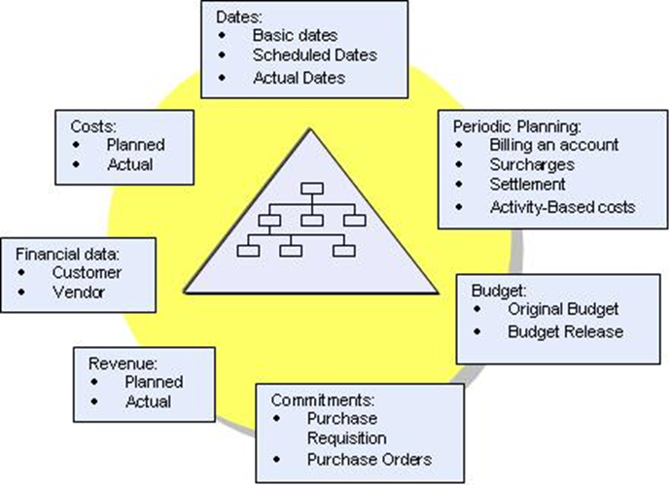
Individual tasks required to carry out the project is called WBS elements

Slide 19
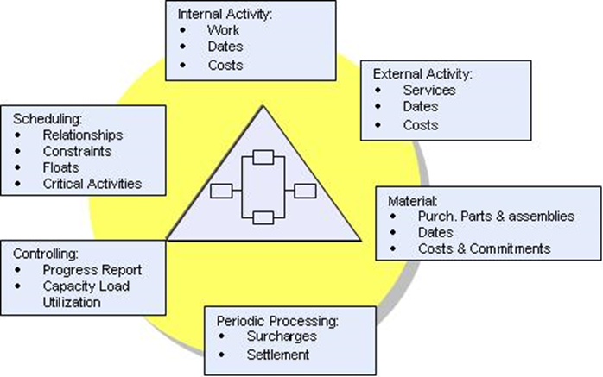
Network
The network describes project processing. Thus, the Network contains instructions on how to carry out activities in a specific way, in a specific order and in a specific time period.

Slide 20
Activities
Activities are used to plan project staffing, capacity, material, PRTs, and service requirements.
Three categories of activities in the Project System:
Internal Activities
External Activities
General Cost Activities

Slide 21
Activity element
Activity element is an activity which is subordinate to another activity. Activity elements contain the same information as activities. Three categories of activity elements in the Project System:
Work elements
External Elements
General Cost Elements

Slide 22
Activity Type
It’s a physical measure of activity output of a cost center .e.g. hours, number of units produced, machine times, production times.
Trigger predefined functions in network activities.
Carry out earned value analysis.
Determine dates in billing plan for sales orders.
Milestones​
​
Milestones are the events in the project to which particular importance is attached or which trigger predefined functions. In PS milestones are used to:

Slide 23
Relationships
You use relationships to depict chronological and technical dependencies between activities.
FS Relationship:
SS Relationship
An activity does not start until the preceding activity is completed.
An activity cannot start unless another activity has started.
FF Relationship
SF Relationship
An activity cannot be completed until another activity has been completed.
An activity cannot be completed until another succeeding activity has stared.

Slide 24
Confirmations
It is a part of network control. It documents the state of processing for the network activities and activity elements.
Confirmations are used to record
The work centre where the activity was carried out.
The person who carried out this activity.
The yield and scrap produced in an activity.
The actual values for the duration and dates.

Slide 25
Case Study
Example instance of a construction project of a building.
Let say there is a construction company that is going to construct a Multi-Storey building.

Slide 26
SAP QM (Quality Management)
SAP Quality Management is a part of SAP R/3 system and is integrated with other SAP modules like SAP Material Management (MM), Production Planning (PP), and Plant Maintenance (PM).
QM is an integral part of logistic management and it is used to perform quality functions such as quality planning, quality assurance, and quality control, at various stages such as incoming material stage, in-process manufacturing process stage, and after production as well.

Slide 27
As SAP Quality Management is an integral part of SAP R/3 system, it performs the following key functions in manufacturing of goods-
Quality Planning
Quality Notifications
Quality Inspection

Slide 28
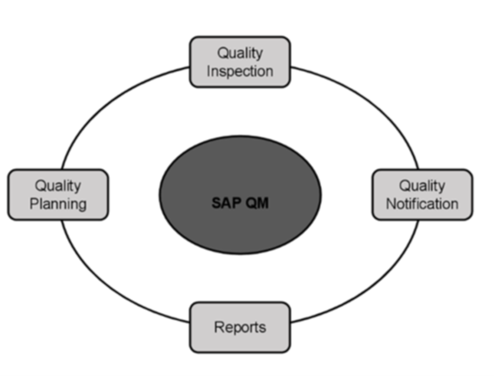
In the following diagram, you can see the key components that are involved in SAP Quality Management process.

Slide 29
Standard Reports
You can create reports in QM system to check how many times a product has been identified with a defect and improvement areas that your company has to implement. There are number of reports that can be generated in QM-
Material Defects Report
Vendor Defect Report
Customer Defect Report

Slide 30
References
https://www.sap.com/documents/2018/08/7a62516c-157d-0010-87a3-c30de2ffd8ff.html
https://open.sap.com/courses/mm4h2
https://www.udemy.com/topic/sap-mm/
https://blogs.sap.com/2008/05/09/sap-project-system-a-ready-reference-part-1

Slide 31
SAP QM – Functions
These functions comprise to form Quality Management process. In SAP QM system, you can perform the following functions-
Quality Planning
Quality Inspection
Quality Control
Quality Certificates

